Slide 1
The Future of Work
Trends Impacting the Safety Profession
A Discussion of ASSP’s 2023 Corporate Listening Tour
Prepared for: Fall 2023 Regional Operating Committee Meetings

Slide 2
Trends Impacting ASSP
ASSP’s Board of Directors is committed to utilizing trends impacting safety to inform ASSP’s strategic future. One of the outputs reviewed annually is the results of the ASSP Corporate Listening Tour.
ASSP is making the information available to regional leaders to:
Share the findings with leaders;
Encourage dialogue with leaders and members; and
Support members to engage with their organization’s leadership

Slide 3
How to use this presentation and the report
The presentation and report are designed to facilitate a discussion. Fascinators are encouraged to:
Allow or 45-60 minutes for the discussion
Enhance the talking points to include any personal experience
Share the report in advance of any facilitated discussion
Capture any key insights and share them with ASSP leaders, including the Board (email Executive@ASSP.org)

Slide 4
The Future of Work
Trends Impacting the Safety Profession
A dialogue on the results of ASSP’s 2023 Corporate Listening Tour

Slide 5



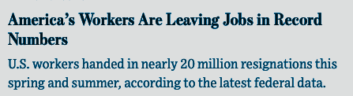

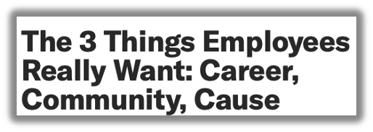

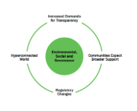
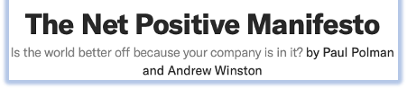
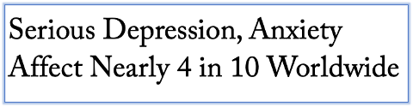

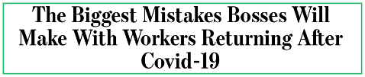

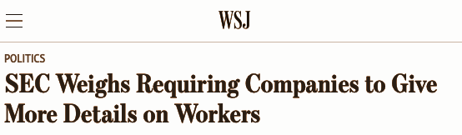

What Is keeping leaders awake?
Notes:
What’s Keeping Leaders Awake?
The struggles and suffering of the world are real and are impacting every organization in one way or another.
Organizational leaders can no longer separate the ills of the world from how they run their business.
CEOs are required to operate at a higher standard and create a more sustainable, equitable business model.

Slide 6
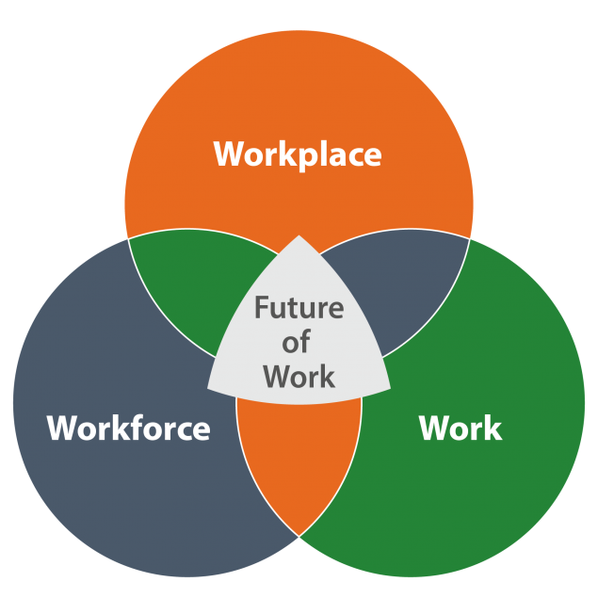
NIOSH
Future of Work Initiative
https://www.cdc.gov/niosh/topics/future-of-work/resources.html
Notes:
Future of Work
In 2019, NIOSH launched the Future of Work Initiative. a collective effort of transdisciplinary research, and communication throughout NIOSH, other government agencies, and organizations.
A key goal of the Future of Work is to connect trends in workplace, work, and workforce changes to prepare for the future of occupational safety and health.
Trends and the future of work guides ASSP’s Board of Directors to ensure ASSP is positioned to help you meet this new and evolving challenges.
https://www.cdc.gov/niosh/topics/future-of-work/resources.html

Slide 7
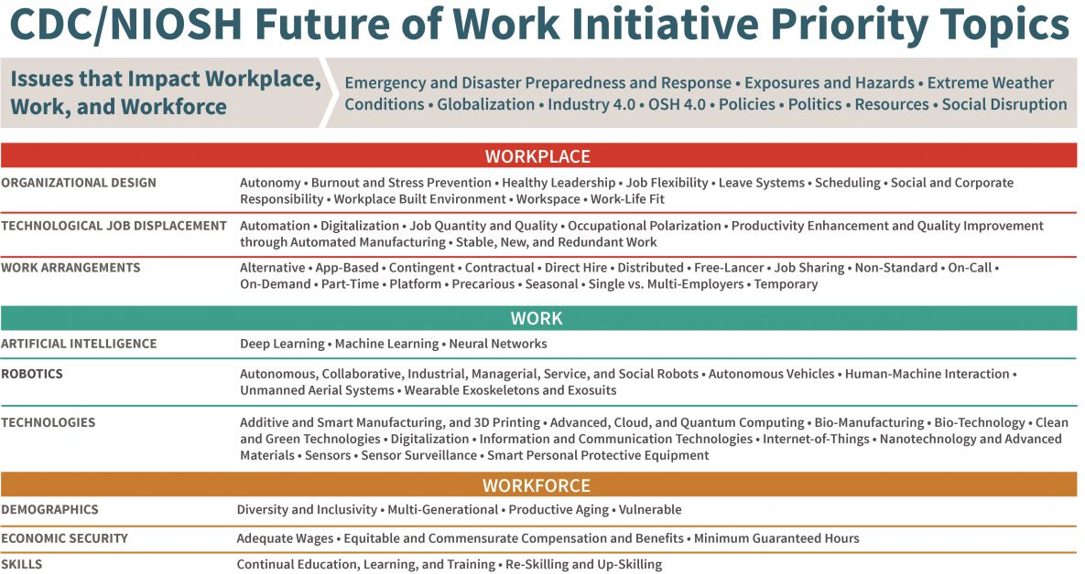
Notes:
To highlight a few:
Organizational Design
Technology Job Displacement
Work Arrangements
AI
Robotics
Technologies
Skills
For the past 12 months ASSP has been on a listening tour with members to understand the impacts of these trends on their day-to-day roles.
We asked directly how trends are driving business and safety. What we learned will not surprise you, I hope it will motivate you to act….

Slide 8

Corporate Listening Tour
Themes Continue
Continuity of Operations
Disaster Preparedness
Accelerating Pace of Change
Technology and Managing Organizational Risk
Notes:
Corporate Listening Tour
This year’s Executive Listening Tour started in January, just after the U.S. Bureau of Labor Statistics (BLS) released 2021 fatality data.
To remind us all, BLS reported that the fatal occupational injury rate of 3.6 fatalities per 100,000 full-time equivalent workers in 2021 represented the highest annual fatality rate since 2016.
A statistic I know we all want to see reduced.
So, what did we hear?
This year, many of the key themes identified in previous listening tours continue to influence business operations and safety including:
continuity of operations,
disaster preparedness,
the accelerating pace of change,
and the role that technology plays in managing organizational risk.

Slide 9

Governance Matters (Workplace)
Where direct accountability is driven at the top, outcomes are achieved.
Where the reporting structure is not to the C-suite, OSH struggles to have voice and influence.
Notes:
The HEADLINE: Governance Matters (Workplace)
New themes emerged with intensity including the role of corporate governance, Environment, Social, Governance (ESG), and geo-political forces impacting global business and economy.
We defined governance as corporate board and management structures, as well as company policies, standards, information disclosures, auditing and compliance issues.
What does any of that have to do with safety? Everything.
Where direct responsibility and accountability happen at the top, Boards of Director, C-Suite and the investor community, safety outcomes are achieved.
Where the reporting structure is not directly linked, OSH struggles to have voice and influence.
Additional influencing factors include:
Location of Headquarters,
central vs decentral decision-making,
reporting structures.
What does this mean for you?
For OSH professionals, it is critical to understand the structural impact of decision-making. This goes beyond the website and annual reports to how money and accountability flow across an enterprise.

Slide 10

Workforce Fluidity (Workforce)
Finding workers
Shifting work arrangements
Turnover and lack of skilled workers
Temporary and contract workers
Notes:
Workforce Fluidity (Workforce)
Access to talent continues to be a top issue and will be for the foreseeable future.
Shifting work arrangements, turnover, and the lack of skilled workers increase safety risks.
Unskilled, temporary and contract workers are creating continued risk.
Lack of sufficiently skilled labor is increasing burnout and stress.
In some cases, companies are turning to AI to close the gap, introducing new risks in the workplace.
Increased worker expectations are impacting company policy.
The workforce is commanding high salaries and safer work environments, forcing companies to rethink policies and structure, making investments in the future.

Slide 11

Continued Evolution or At-Risk (Workforce)
Moving beyond technical skills
Future-focused lens
Skills reflect operational and business interconnectivity (Industry 4.0)
Notes:
Continued Evolution or a Profession At-Risk
The changing nature of work has a direct impact on you as professionals.
For the past several years, executives have indicated the need for the profession to evolve. OSH professionals need to understand business operations and corporate decision-making.
COVID-19 global pandemic shifted safety priorities and added pressure to already stressed safety professionals.
Executives agree OSH professionals have the technical skills required to offer technical support. However, that is not enough in today’s fast-paced and changing work environment.
To be credible, OSH professionals need to understand the processes and how safety controls are impacted by the changing world of work, and operational and business interconnectivity.

Slide 12
How Will This Change My Organization, Safety and My Role?
Accelerators
Are decision-makers backing change?
Is there a strong need for change?
Do economic or regulatory conditions favor change?
Will younger generations push change?
Decelerators
Are there regulations that dampen change?
Are decision-makers working against change?
Do economics work against change?
Does change work against societal or stakeholder value?
Notes:
How will this change my organization, safety, and your role?
Accelerators could be:
Are decision-makers backing change?
Is there a strong need for change?
Do economic or regulatory conditions favor change?
Will younger generations push change?
Decelerators could be
Are there regulations that dampen change?
Are decision-makers working against change?
Do economics work against change?
Does change work against societal or stakeholder value
As a professional, you need to understand the governance structure and the points of influence (Accelerators and Decelerators).

Slide 13
Opportunity in a Time of Change
Vision
Plan
Act
Understand
Notes:
Opportunity in a Time of Change
As OSH professionals, you are uniquely positioned to connect people and profitability as guardians of change management, influencing decision-makers.
Understand: Understand the context of governance and decision-making in the organization. Be curious and ask questions.
Vision: Based on the structure, inform direction. Exploring possible futures that could result from the identified changes, you will move into thinking about what the organization might need to achieve a desirable outcome—your preferred future.
Plan and Connect: Work with operational leaders to set actionable steps to make the vision a reality.
Act: with Foresight with the understanding and modeling informed by the top governance decision-makers.

Slide 14
Start a Conversation With Leaders
Which of these trends is affecting our company the most? Are our current measures addressing the issues effectively?
How is safety integrated into our decision-making processes? What more can we do to ensure it is prioritized and whose support do we need?
What challenges has our company faced in maintaining safety during times of high turnover? How can we overcome those challenges in the future?
How do the results in this report affect my role as an OSH leader in my company? What changes should I make to more effectively address these trends?
How can we spread awareness of these findings to other leaders in our company and get them involved in acting on safety issues?
Notes:
It starts with a Conversation
In advance of today’s discussion, we distributed a copy of the results of the listening tour.
Today, we will consider the five facilitation questions provided in the report. Our discussion is not limited to these five questions, they are designed to start our conversation.

Slide 15
Debrief
Do we have any key insights we want to document or share with the Board? (email to Executive@ASSP.org)
How could we use what we learned today to support our members?
Next steps, if applicable.

Slide 16
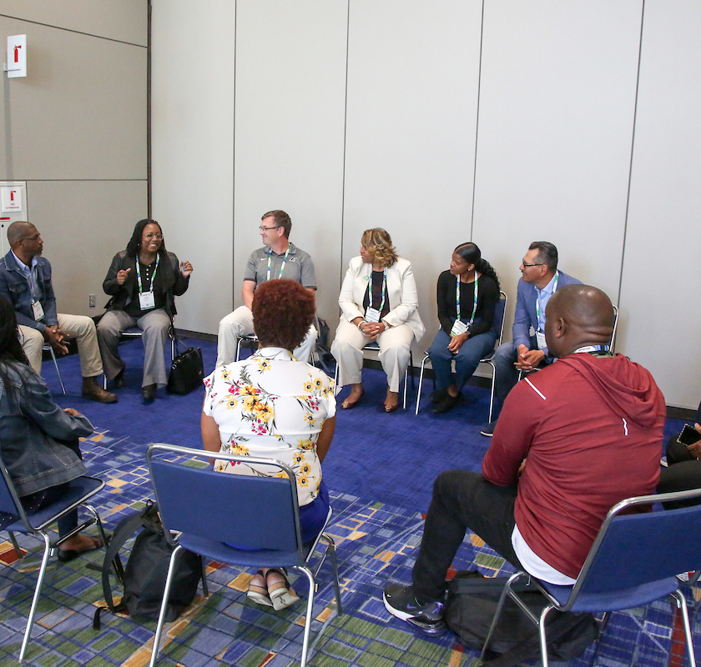
Connect
Jennifer McNelly, CAE
Chief Executive Officer
American Society of Safety Professionals
LinkedIn: Jennifer McNelly
executive@assp.org
Notes:
Develop Your Career
There is so much you cannot control; however, you can control how you lead and build your capabilities beyond technical expertise to owners of change management and trusted business partners.
I encourage you to deepen your understanding of the trends impacting your organization.
And invitation from ASSP CEO Jennifer McNelly to connect and keep this conversation moving forward

