Slide 1
Empathetic Leadership
Improving Leadership, Safety, and Wellbeing
Amy McCae
Holistic Wellness Coach. Mindfulness Meditation Teacher. Corporate Wellness Trainer

Slide 2
Welcome
Thank you
Who I am
What I do
My intention:
Understand and experience emotional intelligence, especially empathy, so that you are inspired and empowered to develop the skill and use if for improved leadership, safety, and well-being.

Slide 3
Pause

Slide 4
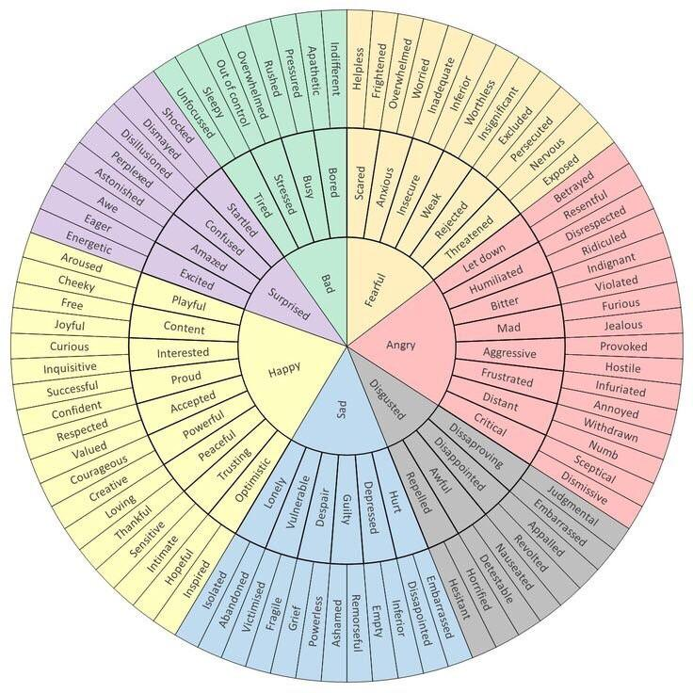
Name it to tame it?
Hand analogy

Slide 5
Emotional Intelligence
Recognize, understand, and manage your own emotions; and recognize and influence the emotions of others.
How useful would this be when dealing when dealing with a manager that does not want to implement suggestions or dealing with an employee after an accident?
Mindful Feelings Experience
You don’t adjust to the energy of the room you shift it.

Slide 6
Self-Awareness
Understanding and knowing your values, beliefs, strengths, weaknesses, thoughts, feelings, and more.
To be an effective leader, practice well-being, and create a safe place you must 1st know you.
Synergist 10/21 says you are all “Advocates for behavioral change and safety culture.”
How can you do that if you don’t know yourself?
Less stress and anxiety with conscious choices.

Slide 7
Empathy
Identify and experience the emotion of another.
*Mirror Neurons
Empathy moves you to compassion.
Compassion drives to you act.
Most needed, valuable skill that will improve all interactions with people.

Slide 8
Psychological Safety
Be Empathetic-
Be kind, resilient, adaptable, ask questions, put yourself in their shoes.
Insure Trust-
Be selectively vulnerable. Tell a story. Respond positively and lead/provide the path.
Be Self-Aware and Emotionally intelligent-
Understand yourself, intentions, and keep your thoughts and emotions in check.
*Remember that mental and physical health are not separate.
*Remember that safety, leadership, health, and environment are not separate.

Slide 9
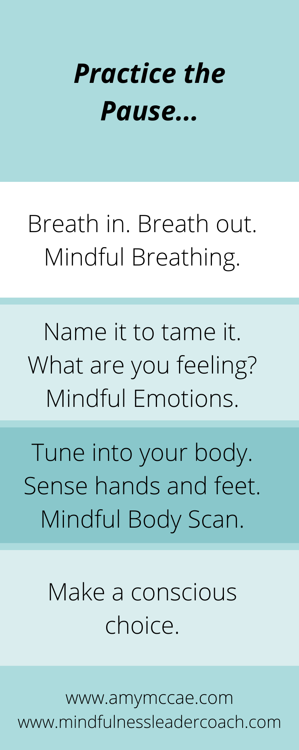
Would this improve safety?
Leadership?
Wellbeing?
In what ways?
What can you differently today?

Slide 10
Prefrontal Cortex = 9 Aspects of Wellbeing
*Bodily Regulation
*Insight
*Attuned Communication
*Empathy
*Emotional Balance or Regulation
*Fear Modulation
*Response Flexibility
*Intuition
*Morality
*10th is thought to be GRATITUDE!

Slide 11
Common Concerns
Compassion, Curiosity, and Communication
Chemical exposure or problem/issue resolved according to OSHA but employees still having symptoms.
IH- Bad rap as “Mad Scientist.”
Explaining the issues and the person not being receptive.
Stress and anxiety.
Dealing with the aftermath of employee injuries with coworkers and peers.
Managers that do not want to implement suggestions.

Slide 12
Can you hear me now?
The single biggest problem in communication is the illusion that a conversation even took place.
Listening
Looping
Dipping
3 Minute Communication Exercise/Online to journal
Walk through issues/Role play/practical application

Slide 13
Practice the pause.
“Between stimulus and response there is space. In that space is our power to choose our response. In our response lies our growth and our freedom. “
Viktor Frankl

Slide 14
Thank you!
Being advocates for behavioral change and safety culture means:
*Developing emotional intelligence to make conscious decisions that lead to empathetic and effective leadership.
*Practicing self-awareness and communicating effectively for all levels of safety including psychological safety.
*Improving wellbeing through physical as well as mental and emotional processes and needs.
Questions

Slide 15
amymccae@gmail.com
www.mindfulnessleadercoach.com
www.amymccae.com
www.Linkedin/in/amymccae

